Slide 1
WEB SCRAPING USING NODE.JS
Internship at national informatics centre
R.Gayathri - Vellore Institute of Technology
Notes:
1)Greetings.
2)Initial discussion on project-when and what

Slide 2
SUMMARY
The purpose of this project is to create a web-based application that helps in web scraping
The tool used to achieve this objective is Node.js, which is an open-source server providing an environment for execution of JavaScript
In this package, the server side of the program aims to extract the filenames, present in link format, in the specified URL
The client side of the program is displayed in the form of a webpage
Notes:
1)Objective
2)Tool chosen and why
3) Server and client

Slide 3
INRODUCTION
Why web scraping?
Web scraping saves us the trouble of manually searching and extracting data. It speeds up the process by creating easy access to the data
It has been used in many real-world applications like Finance, Marketing and also in Research fields such as Data science and Data analysis. In this project, the module aims at extracting only the links from the given URL
Knowing which component of the web page to extract, and specifying its format narrows down the search process and scraping
Notes:
Examples:

Slide 4
MODULES
node_modules - directory containing necessary libraries
package.json - metadata for the application
function.js - web scraping and stores the result as a json
list.json - file containing the result
index.js - renders the result as a drop-down list to a html page

Slide 5
IMPLEMENTATION
Function.js
This module contains the web-scraping method fully defined to do the required task. There are some dependencies like cheerio, request and fs to be installed and imported into respected variables.
When the execution of this method starts, it makes a request to the given URL and loads the HTML page of that URL into a variable. A looping statement is used to scan the page for “a” tag and “href” attribute.
Using the basename() function, the name of that attribute is sliced and stored into the object. This object is converted into a string using the stringify() method, and a JSON file is written.

Slide 6
IMPLEMENTATION
Function.js
cheerio module:
Cheerio parses markup and provides an API for manipulating the resulting data structure. Jquery can be used to perform tasks.
request module:
To make a request to any url
fs module:
To perform file operations

Slide 7
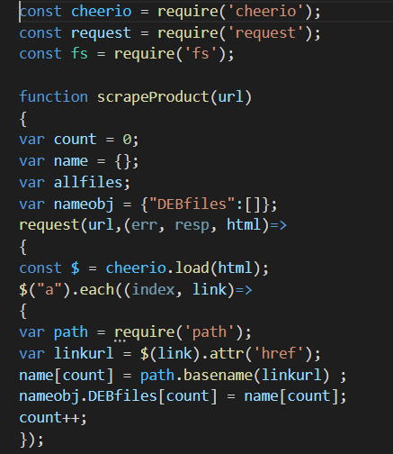
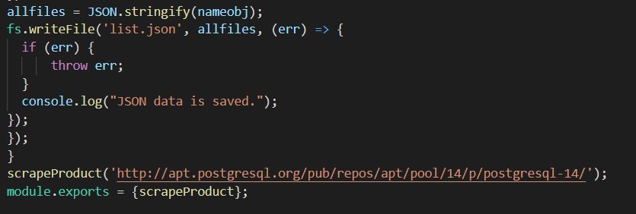
CODE

Slide 8
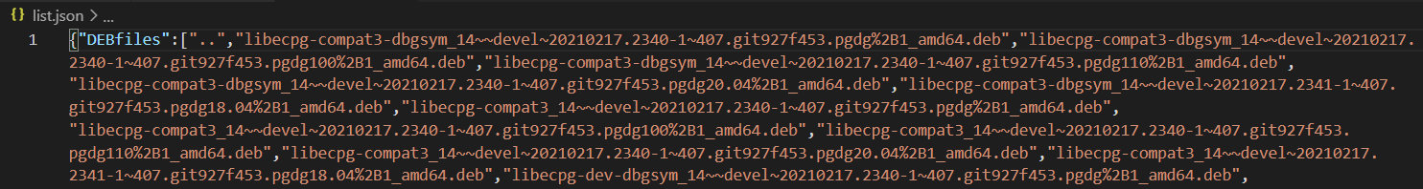
OUTPUT
list.json
This file contains a list of all the filenames extracted.
It is dynamic and can be modified at anytime. File names can be added or deleted whenever needed.

Slide 9
IMPLEMENTATION
Index.js
This is the main program of the project, and the execution begins here. The ScrapeProduct() method from function.js is exported, and index.js imports it into a variable.
This module acts like an API and uses express.js to render the contents into a HTML page. The express module is imported into the app variable. The get() function is used to make a request and deliver a response.
It calls the ScrapeProduct() function which gives an output, all the contents of the list.json file is loaded into a variable. It also recursively writes each file name into the page as a drop-down list. The port chosen here is 8080.

Slide 10
IMPLEMENTATION
Index.js
express module:
Express is a minimal and flexible Node.js web application framework that provides a robust set of features to develop web and mobile applications. It facilitates the rapid development of Node based Web applications.
app:
app starts a server and listens on the specified ports for connections. You define routing using methods of the Express app object that correspond to HTTP methods

Slide 11
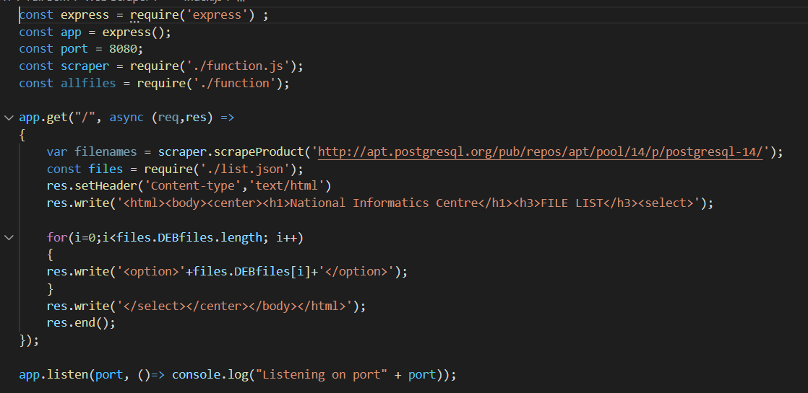
CODE

Slide 12
RESULT
The execution is done using the command “node index.js” in the VS Code Terminal
The result can be viewed at the localhost webpage - http://localhost:8080/
Thus, the web scraping using Node.js + Express.js has been implemented successfully

Slide 13
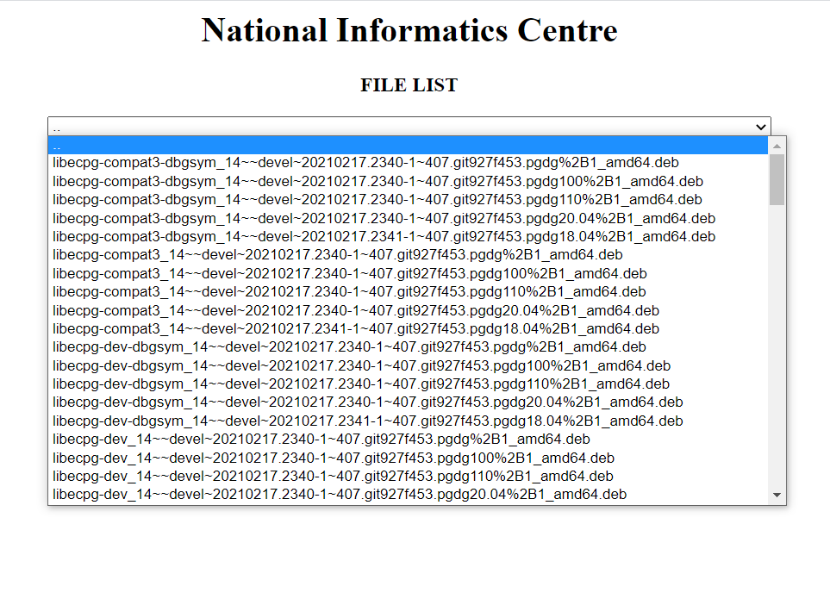
OUTPUT
http://localhost:8080/
Web page which contains a drop down list of all the extracted file names

Slide 14
REFERENCES
Download Node.js - https://nodejs.org/en/download/
Download VS Code - https://code.visualstudio.com/download
https://www.youtube.com/watch?v=7FjhF6Hy9gY&t=391s
github - https://github.com/Gayathri99Ravichandran/WebScraping-using-NodeJS

Slide 15
THANK YOU

